Slide 1

“Call 4 Wheel” Car Rental Website

Slide 2
Presenters
Name | Roll No. | PRN No.
Aniket Dhoke | 313018 | 22110835

Slide 3

Introduction
The website provides a seamless and convenient solution for renting cars to meet your transportation needs. It offers a wide selection of cars with flexible rental options and an easy booking process. When you choose Call 4 Wheel Car Rental, you gain access to a diverse range of vehicles that cater to different preferences and requirements. Whether you require a compact car for a solo journey, a spacious SUV for a family trip, or a luxury sedan for a special occasion, our fleet has the perfect vehicle to suit your needs.
The website features a user-friendly interface and an intuitive booking system, making the car rental process effortless. The transparent pricing policy ensures that you have a clear understanding of the costs without any hidden fees or surprises. At Call 4 Wheel Car Rental, customer satisfaction is prioritized. The dedicated team is committed to providing exceptional service throughout your car rental journey.

Slide 4

The Need for a Car Renting Service
In today's fast-paced world, having access to a reliable car renting service has become essential. Whether you're traveling for business or pleasure, having the convenience of a rental car can save you time, money, and provide you with the freedom to explore at your own pace.
At 4 Wheel Car Rental, we understand the importance of meeting this need and strive to provide top-notch service that exceeds your expectations. With our commitment to customer satisfaction and a wide range of benefits, renting a car has never been easier.

Slide 5
Benefits of Renting from Call 4 Wheel Car Rental
Wide Selection of Well-Maintained Cars
Competitive Pricing
Flexible Rental Options
Choose from diverse fleet of vehicles, ranging from compact sedans to spacious SUVs.
Enjoy highly competitive rental rates, ensuring you get the best value for your money.
We offer flexible durations, allowing you to rent a car for a few hours or a few days.
Convenient Pickup and Drop-off
Excellent Customer Service
Our multiple locations make it easy for you to collect and return your rental car.
The dedicated team is here to assist you throughout the rental process.

Slide 6
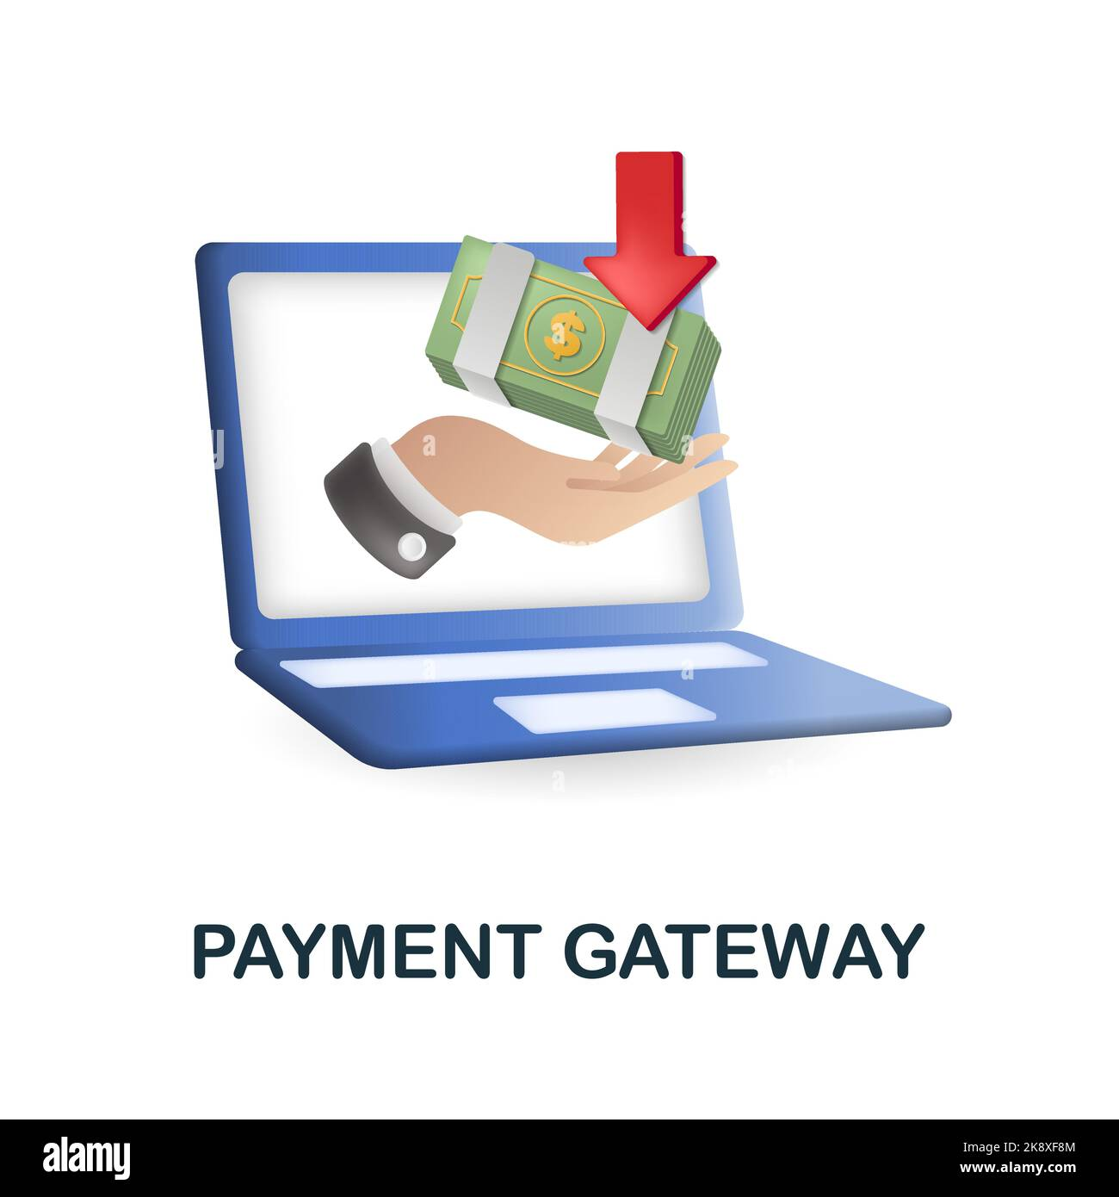
Payment Gateway Integration
Call 4 Wheel Car Rental website seamlessly integrates a robust payment gateway, ensuring secure and hassle-free transactions for our customers. Leveraging cutting-edge financial technology, it offers a wide range of payment options, including UPI, net banking, and credit/debit cards.
It prioritizes data protection and compliance with industry standards to build trust and confidence in our platform. Streamlined checkout process and user-friendly interface contribute to a delightful customer experience.
With the integrated payment gateway, customers can confidently make payments online, knowing that their personal and financial information is kept secure. The system is meticulously designed to handle high volumes of transactions efficiently, ensuring quick and reliable payment processing.

Slide 7




Supported Payment Methods
UPI Payments
Net Banking
Credit/Debit Cards
Seamlessly integrate UPI for fast, secure, and hassle-free transactions.
Offer a wide range of net banking options for customers' convenience.
Accept all major credit and debit cards for a comprehensive payment experience.

Slide 8
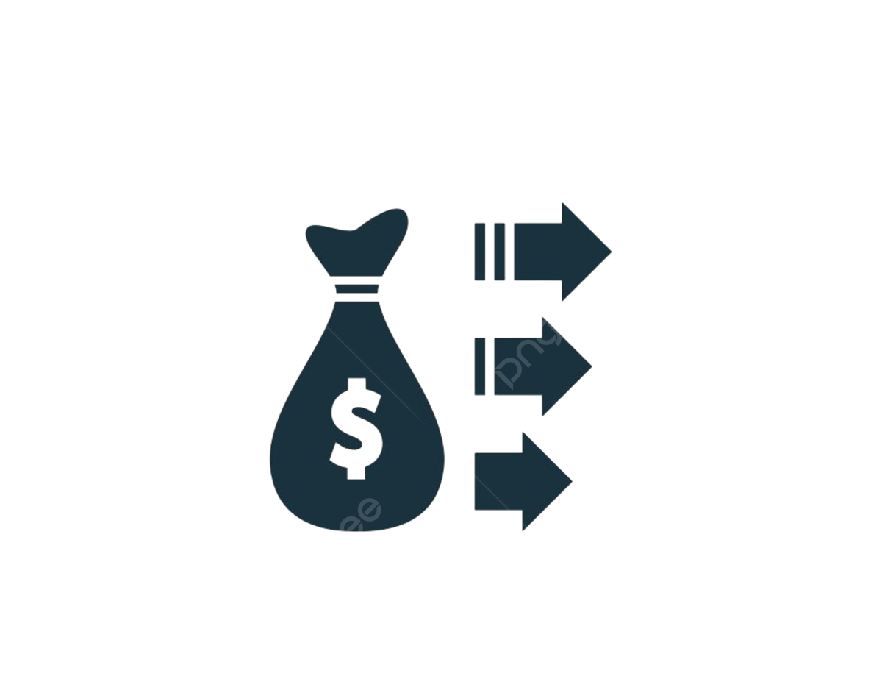


Fintech Revolutionizes Car Rentals
Payment Gateway
Integration
Enhanced Security
Transaction Flexibility
The seamless integration of a versatile payment gateway enables customers to make transactions using various methods such as UPI, net banking, and cards.
Fintech solutions offer advanced security features, ensuring safe and reliable transactions for both customers and rental providers.
The ability to accept multiple payment methods enhances the accessibility of car rentals, accommodating diverse customer preferences.

Slide 9
Streamlined Booking and Payment Process
User-Friendly Interface
Instant Confirmation
Transparent Pricing
Fintech-integrated car rental platform offer intuitive interface for booking and payment, simplifying the overall process for customers.
Real-time booking and payment confirmation provide customers with immediate assurance and eliminate unnecessary delays.
Fintech solutions enable transparent pricing structures, ensuring that customers are aware of the costs associated with their rentals.
Hourly Rates
Diverse Payment Methods
The availability of fixed hourly rates enables customers to pay for the exact duration of usage, optimizing costs for short-term rentals.
The acceptance of various payment methods, including UPI, net banking, and cards, empowers customers to choose the most convenient and preferred mode of transaction.

Slide 10
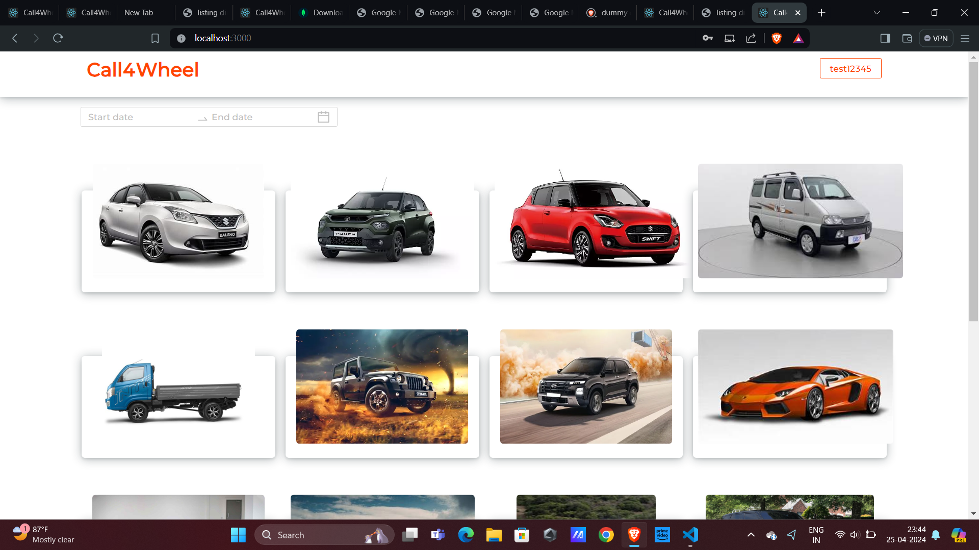
Website Interface
The Call 4 Wheel Car Rental website is designed with the user in mind, offering a seamless and intuitive interface that makes it easy to browse, book, and manage your rental. From the moment you land on the homepage, you'll be greeted with a clean, modern layout and clear navigation options.
The booking process is straightforward, with step-by-step instructions and options to customize your rental duration and vehicle type. We've also integrated helpful features like real-time availability updates.

Slide 11

Conclusion
In conclusion, the 4 Wheel Car Rental website offers a comprehensive solution for all your transportation needs - from bikes and scooters to reliable cars. The intuitive payment gateway allows seamless transactions through various methods, ensuring a smooth and secure experience.
As we move forward, the platform plans to expand its fleet, explore new rental options, and continuously enhance the user interface to provide an even more personalized and enjoyable service. With a commitment to innovation and customer satisfaction, this fintech-driven project is poised to revolutionize the way you explore your surroundings.

Slide 12
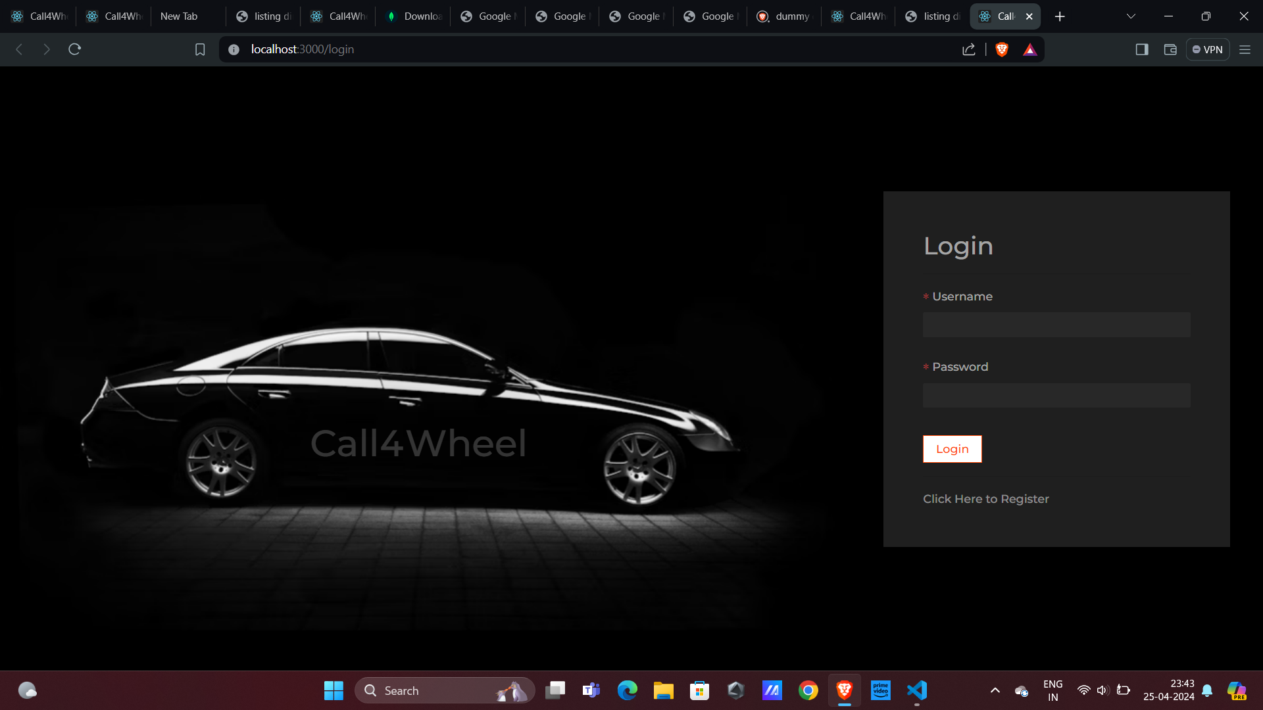
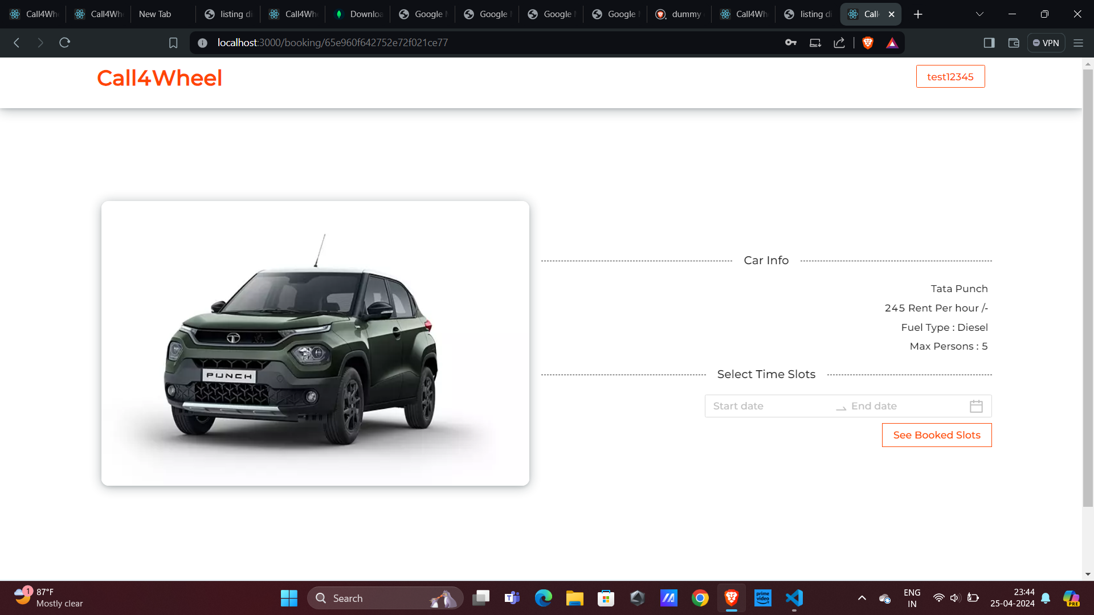
Login
Page
Vehicle
Details

Slide 13
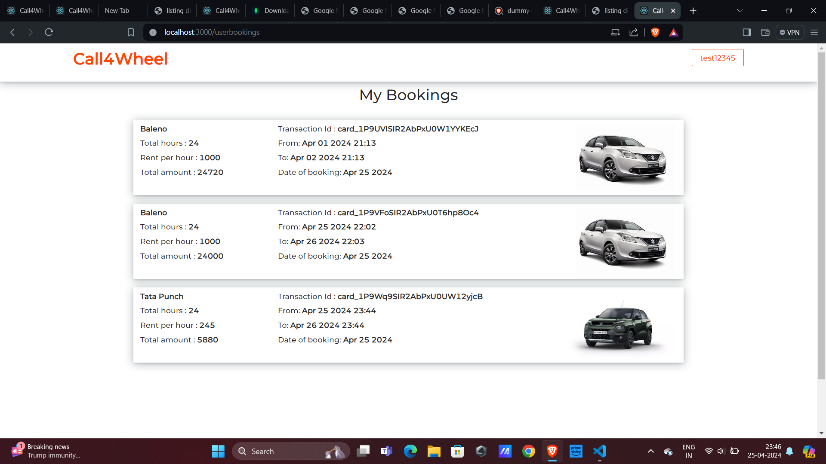
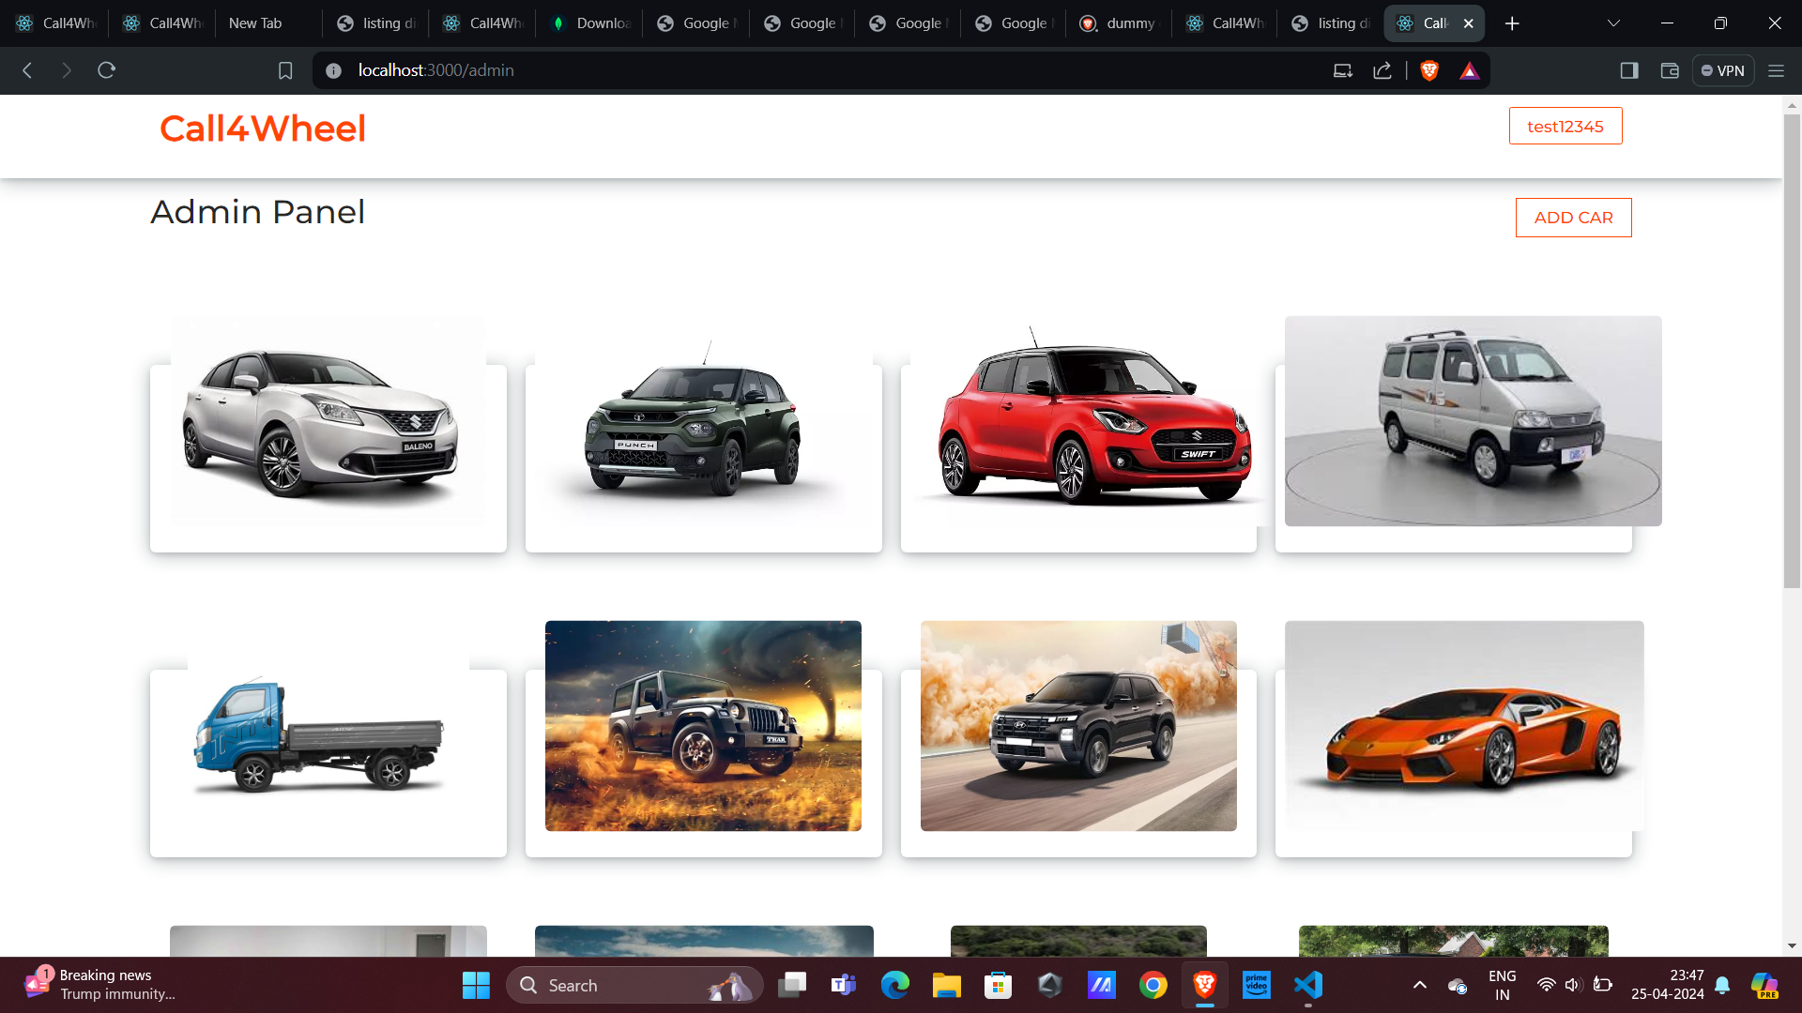
My
Bookings
Admin
Panel

Slide 14
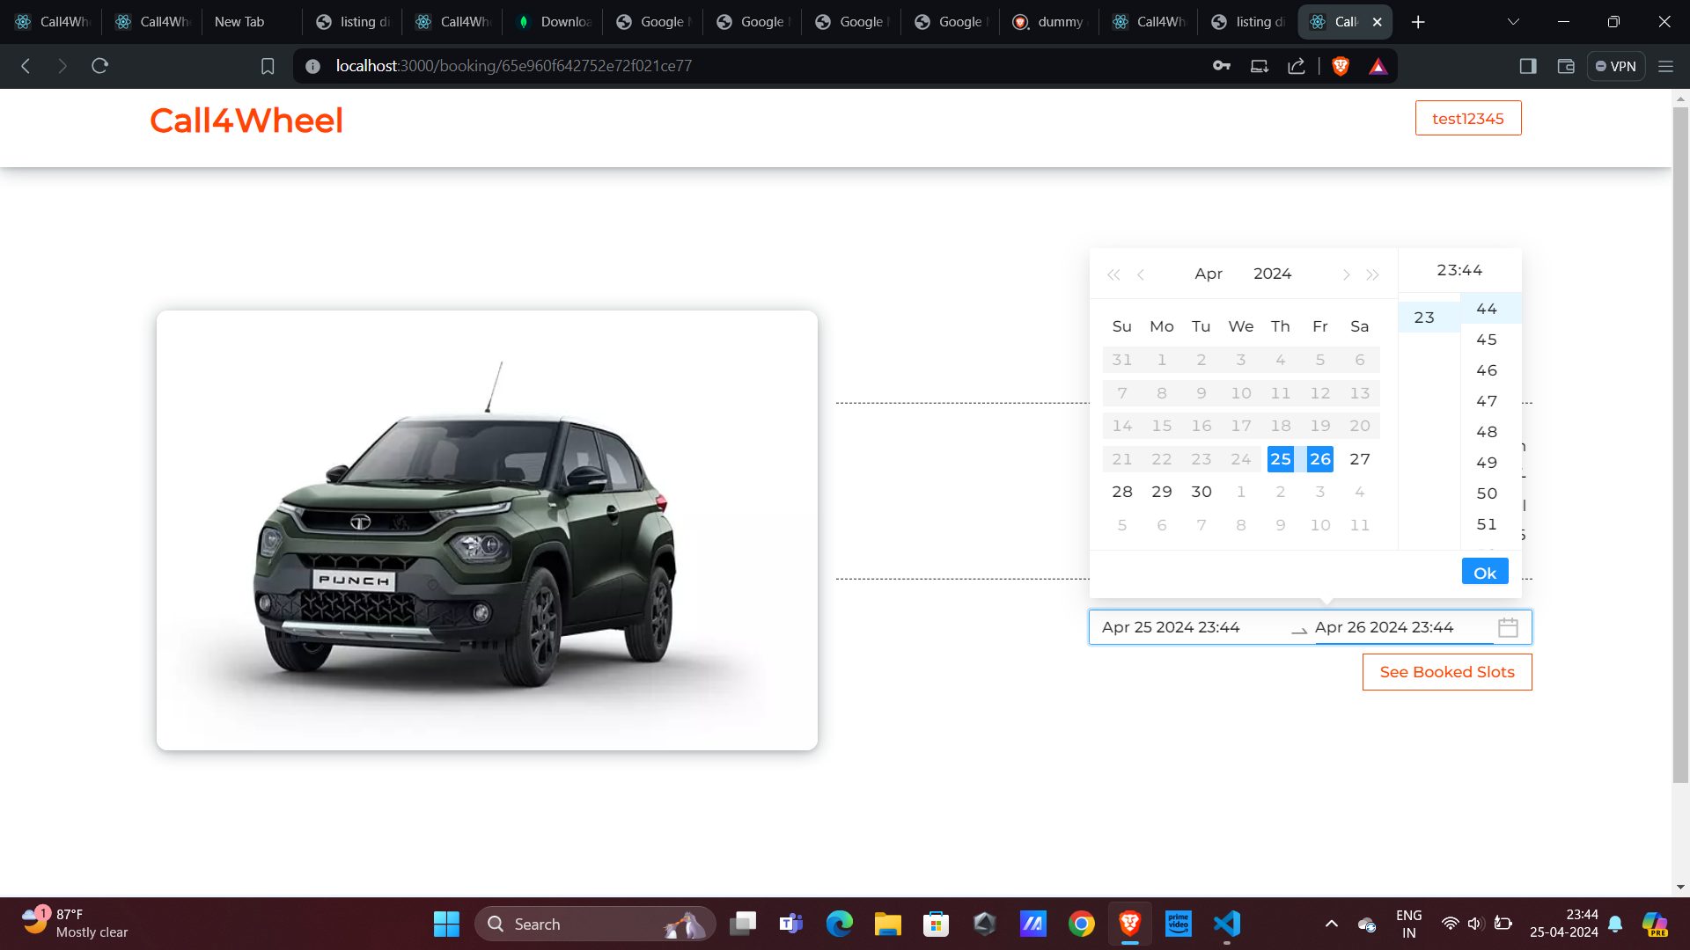
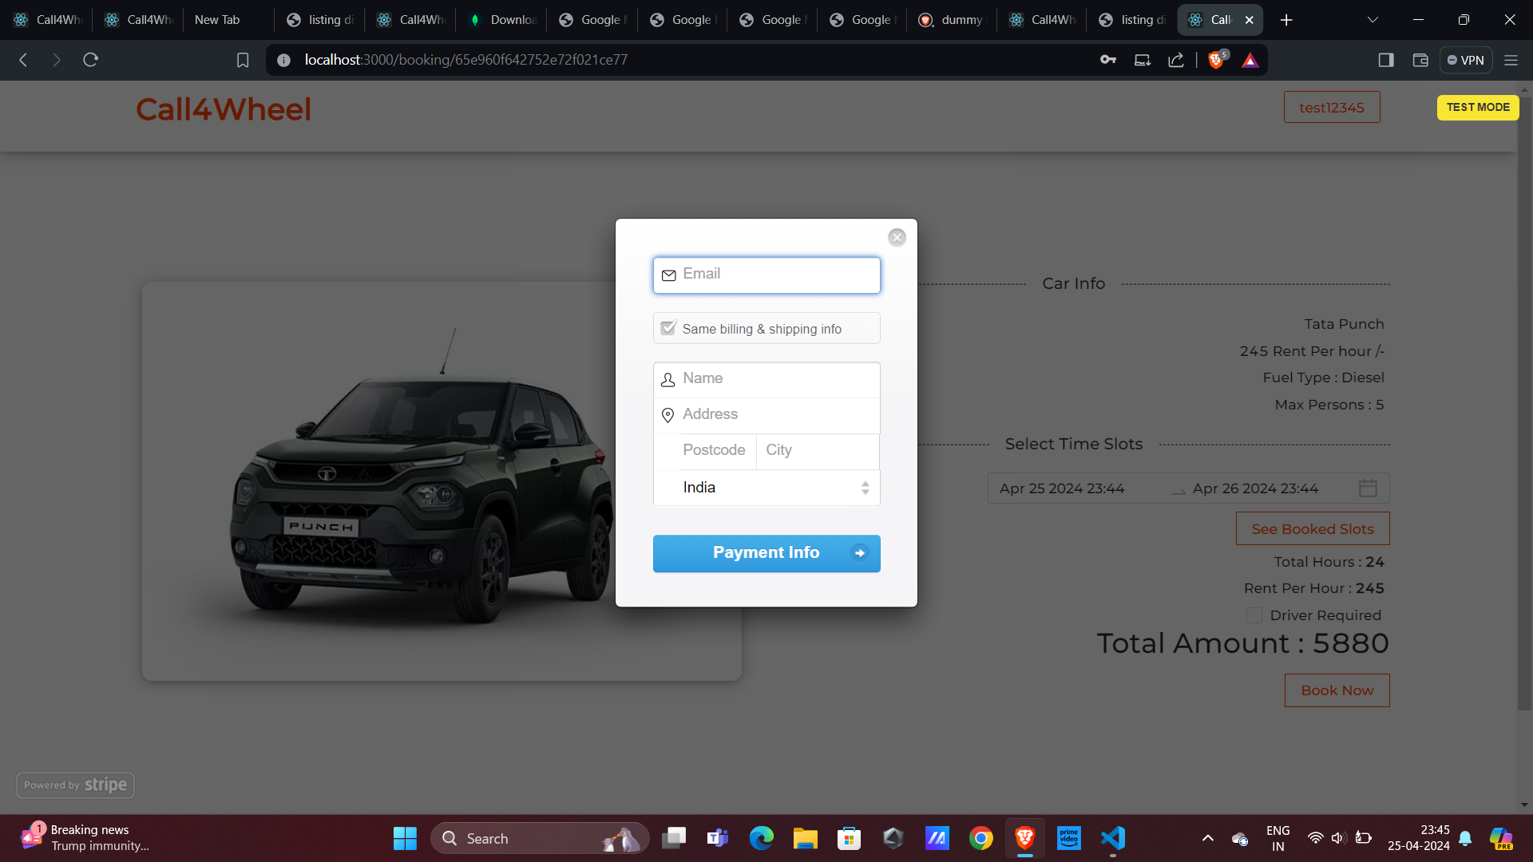
Booking
Details
Payment and
Billing Page

Slide 15
THANK YOU

